Slide 1
Amazon Prime Videos
Data analytics approach
Agbetanmije Olayinka

Slide 2
Agenda
Introduction
Data Cleaning and Preprocessing
Exploratory Data Analysis
Recommendation

Slide 3
Introduction
Analyse dataset to derive insights and make Recommendations
Background
Using dataset from a financial company
Task is to analyze the dataset using Power BI to derive insights and make data-driven recommendations.
The dataset contains information about Amazon Prime videos.
Content of Data Analysis
Movie with the highest number of cast members
Who has directed most movies
Director with most Movie Listings
Movie with the highest Number of Listings
Director with most Movie Casts used
The year with the highest number of cast members
The year with the highest number of Listings
Other Explorative analysis
View Dashboard

Slide 4
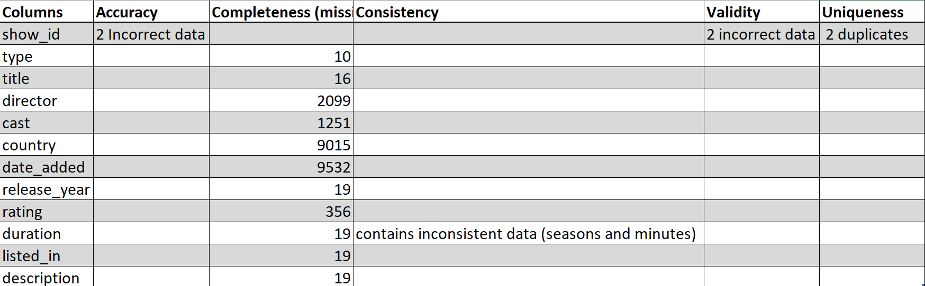
Data Cleaning And Preprocessing
Standard Data Quality Dimensions
Accuracy: correct values
Completeness: data fields with values
Consistency: data free from contradiction
Validity: data containing allowable values
Uniqueness: data that are duplicated
Summary of Data Cleaning and Processing:
show_id: Removed duplicates and incorrect data.
type, title, release_year: Removed empty strings and invalid values.
Custom Columns: Created custom columns for listed_in and cast counts. Also, to address the inconsistencies in duration. Ensured correct Data Types for each columns.

Slide 5
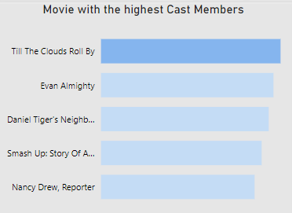
Exploratory Data Analysis
Movie with the Highest Number of Cast Members
"Till the Clouds Roll By" stands out with a remarkable ensemble cast of 76 members.
Released in 1947, it provides a unique perspective on Arts, Entertainment, and Culture during that era.
The movie has a substantial duration of 135 minutes.
Directed by Richard Whorf.

Slide 6
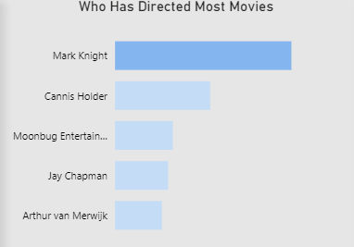
Exploratory Data Analysis
Who Has Directed Most Movies
Mark Knight emerges as the most prolific director on Amazon Prime Video, having directed 113 shows.
This represents approximately 1.17% of the total shows available on the platform.

Slide 7
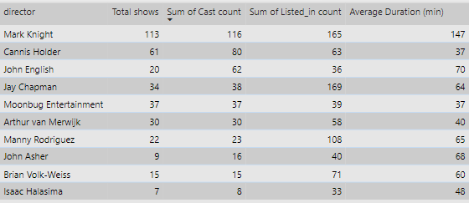
Exploratory Data Analysis
Director With The Most Movie Listings
Mark Knight holds the Amazon Prime Video record for the most movie listings (165).
Furthermore, he has directed a large number of shows (113), demonstrating his prolific production as a director.
The overall number of cast members affiliated with his works is 116.
Mark Knight's films have an average duration of 147 minutes.

Slide 8
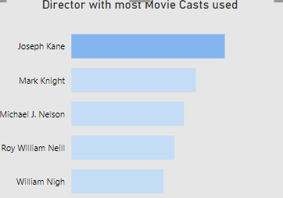
Exploratory Data Analysis
Director With Most Movie Casts Used
Joseph Kane stands out as the director who has utilized the highest number of movie casts on Amazon Prime Video, totaling 143 cast members.
The average duration of movies directed by Joseph Kane is with an average of 56.46 minutes.

Slide 9
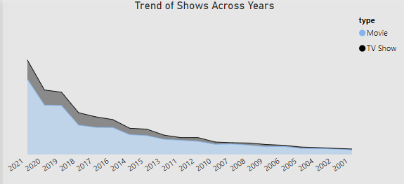
Exploratory Data Analysis
The Year With The Highest Number Movies And Tv Shows
In 2021, Amazon Prime Video experienced a significant surge in content, with the highest number of shows compared to previous years.
The total number of shows in 2021 reached 1,408, comprising 1,123 movies and 285 TV shows.
This represents an upward trend in the availability of shows on the platform over time.

Slide 10
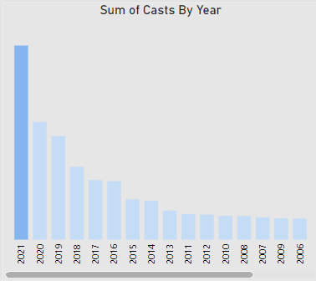
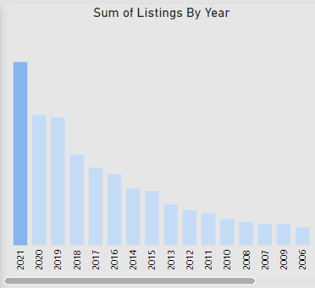
Exploratory Data Analysis
The Year With The Highest Casts And Listings
In 2021, Amazon Prime Video experienced a significant influx of shows, with the most cast members and listings compared to previous years.
The overall number of cast members in movies and TV shows in 2021 was 7,305, reflecting a wide range of talent involved in projects.
Additionally, 2021 had the most listings on the platform, with 2,553 goods available for viewing.

Slide 11
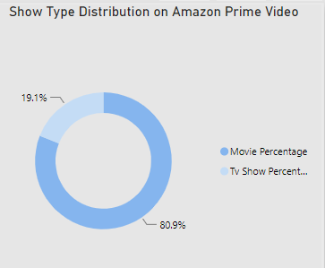
Exploratory Data Analysis
Show Type Distribution on Amazon Prime Video
Amazon Prime Video offers a diverse range of content, with a total of 9,635 shows available on the platform.
Most of the shows consists of movies, representing approximately 80.94% of the total shows.
TV shows make up the remaining 19.06% of the content offerings on Amazon Prime Video.

Slide 12
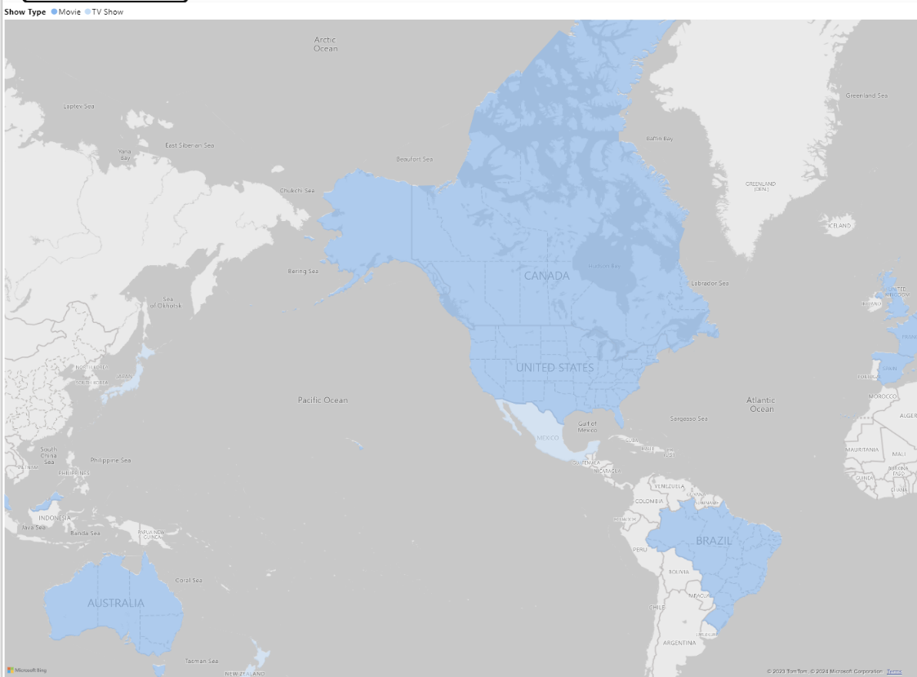
Exploratory Data Analysis
Global Distribution of Amazon Prime Video Shows by Country
The United States leads in the number of shows available on Amazon Prime Video, with a total of 253 shows.
Among these shows, 23.32% are TV shows, while the majority, 76.68%, are movies.
North America, particularly the United States, accounts for the highest number of shows on the platform.

Slide 13
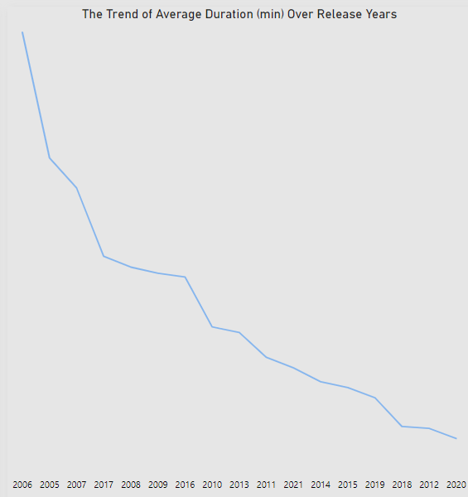
Exploratory Data Analysis
The Trend of Average Duration (min) Over Release Years
Over the years, there has been a significant decrease in the average duration of movies available on Amazon Prime Video.
The average duration of movies is currently 73.97 minutes.

Slide 14
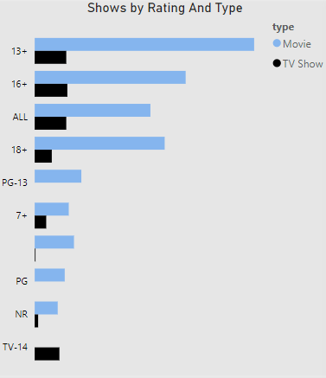
Exploratory Data Analysis
Shows By Rating And Type
Shows rated for ages 13 and up constitutes a significant portion of the shows available on Amazon Prime Video.
There are 1,849 movies and 266 TV shows with ratings suitable for this demographic.

Slide 15
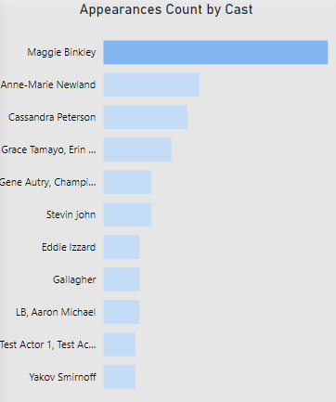
Exploratory Data Analysis
Actor with the highest Cast Appearance
Maggie Binkley emerges as the actor with the highest number of cast appearances on Amazon Prime Video.
With a total of 56 appearances across various shows.

Slide 16
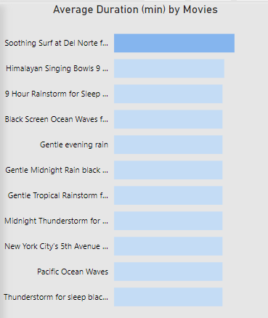
Exploratory Data Analysis
Movie With The Longest Duration in Minuets
"Soothing Surf at Del Norte for Sleep Screen“ movie has the longest duration among the content available on Amazon Prime Video.
With a duration of 610 minutes, this title offers an extended and immersive viewing experience.

Slide 17
Recommendation
Focus on utilizing historical and cultural perspectives: Encourage people to watch classic films like "Till the Clouds Roll By" (1947) to learn about the arts, entertainment, and culture of previous generations.
Support diverse movies creators by recognizing and promoting renowned directors such as Mark Knight and Joseph Kane, whose long filmography demonstrates a wide range of storytelling and production approaches.
Optimize content offerings: Continue to prioritize movies while broadening TV show selections to create a well-rounded content library that appeals to a wide range of audiences.
Recognize North America's supremacy in shows production, notably the United States, while simultaneously looking for ways to highlight and promote shows from other regions.
Address a wide range of audience demographics: Take into account the considerable presence of shows appropriate for those aged 13 and up, as well as family-friendly viewing experiences.
Support talent diversity by highlighting performers such as Maggie Binkley, who contribute significantly to the platform’s shows

Slide 18
Thanks
Data Analysis Done By
Agbetanmije Olayinka

